Slide 1
PC DiCTATOR
Presented By
SYEED ABRAR ZAOAD
ROLL : 23
TAUHID TANJIM
ROLL: 58

Slide 2
OUTLINES:
Objectives
Introduction
Overview
Features
Project Architecture
Multithreaded Programming
Resolving Problems
Challenges
Experiences
Area of Further Improvement
resources

Slide 3
Objectives
Developed Objected Oriented Programming language(JAVA).
Learning about the Graphical User Interface(GUI).
Learning about the networking and multithread in JAVA .
Implement OOP in Making Remote Pc Administration system.

Slide 4
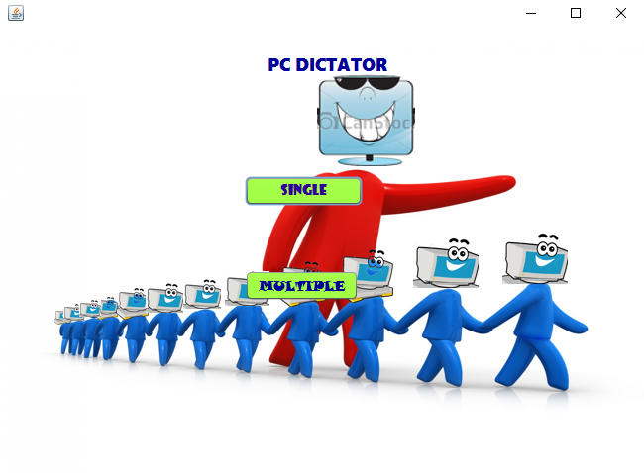
introduction
It is a simple project that can control single or multiple remote computer in a LAN connection

Slide 5
Overview
Divided into two categories:
Single computer administration
Multiple computer administration
Single Computer Administration:
Server control one computer by using client’s command prompt and directly control the clients computer by using its display
Multiple Computer Administration:
Server Control many computer by controlling their commands prompt.

Slide 6
Features
Single computer Administration:
1.Shutdown
2.Restart
3.Sleep
4.Lock
5.Send file
6.Install
7.Fetch a file
8.Delete a file
9.Give a commands
10.Screen control
11.Send a message

Slide 7
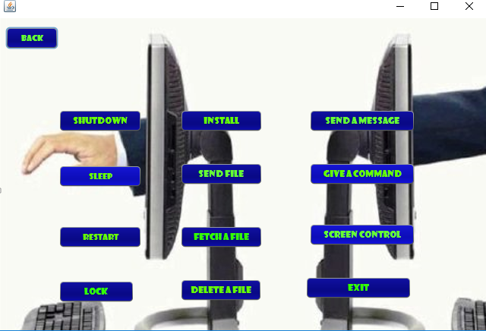

Slide 8
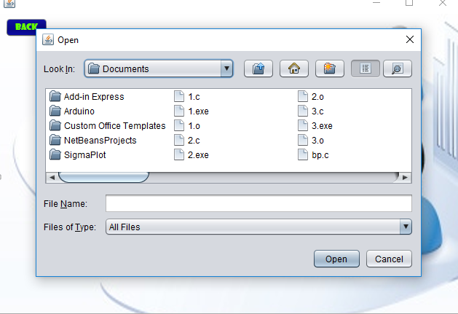
Send file:

Slide 9
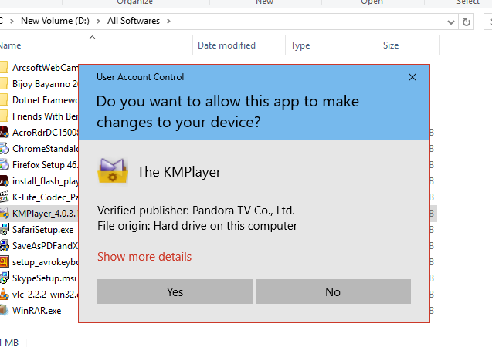
Install a file:

Slide 10
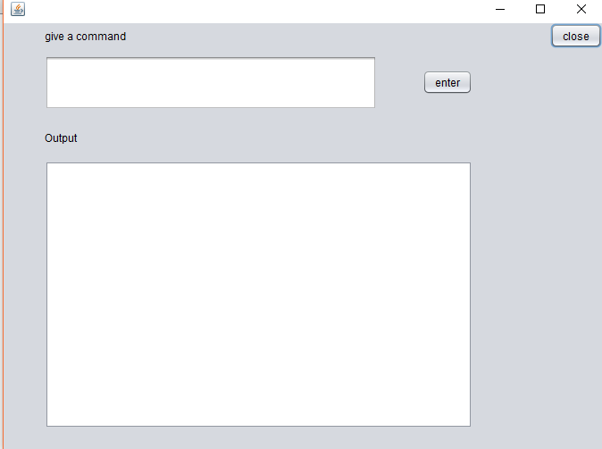
Give a command:

Slide 11
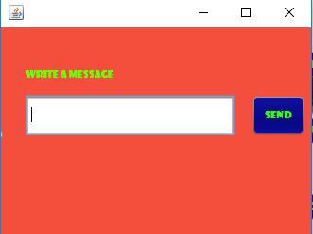
Send a message:

Slide 12
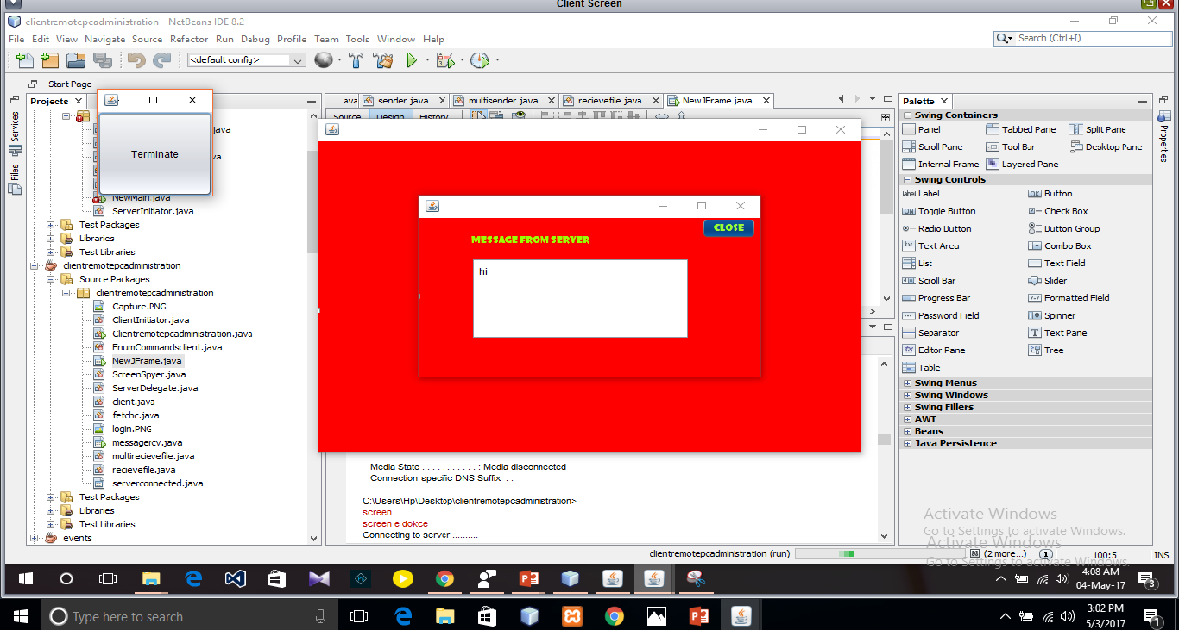
Screen control:

Slide 13
Multiple computer administration:
Shutdown
Restart
Lock
Sleep
Send a file
Install a file
Send a message

Slide 14
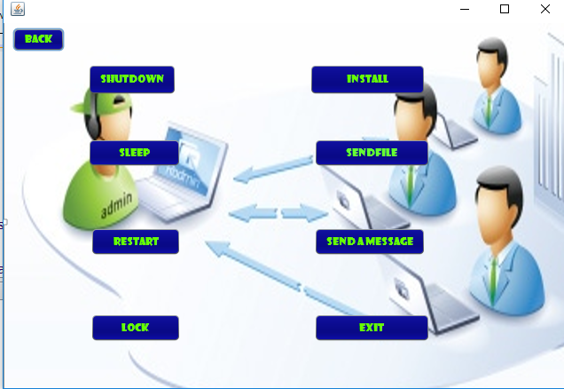
Multiple computer administration:

Slide 15
Multithread Programming(1/2)
Using multithread programming:
Java GUI
1. Sign Up form
2. Mode/ Option form
3. Single mode Features
4. Selecting number of client form
5. Multiple clients features
Sending Command prompt features
Shutdown
Sleep
Restart
Lock

Slide 16
Multithread Programming(2/2)
5. Deleting files
Using Robot class to take screenshots simultaneously and send mouse and
keyboard data simultaneously.

Slide 17
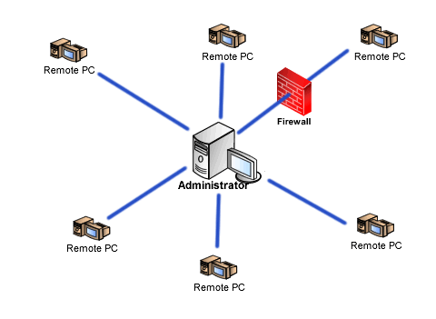
Project Architecture(1/2)

Slide 18
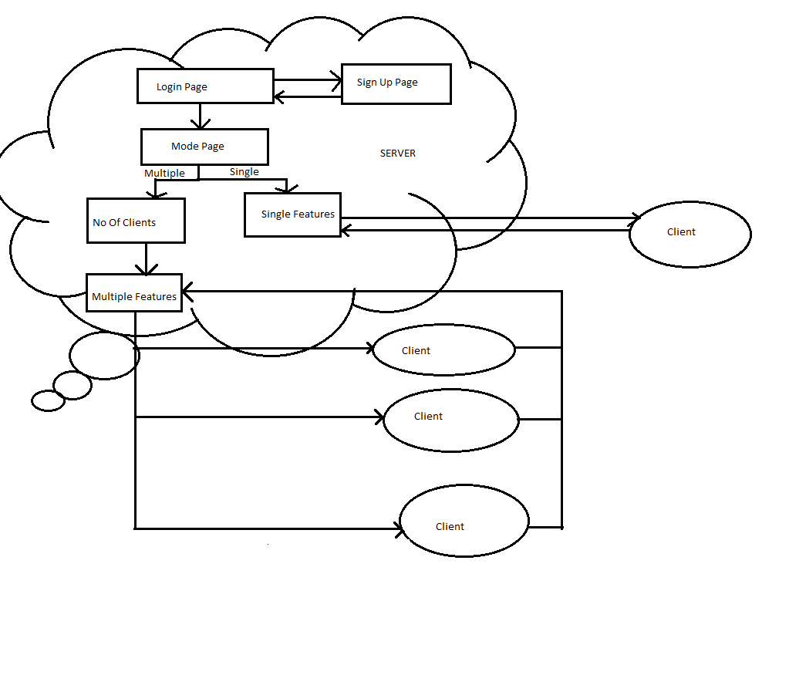
Project Architecture(2/2)

Slide 19
Resolving Problems
Shutting down
Restarting
Sleeping
Locking
Sending files to
Installing files to
single as well as multiple pcs.
Accessing monitor of a single pc and control it by server’s mouse and keyboard.
Deleting files of
Fetching files from
Single pc

Slide 20
Challenges(1/2)
Using command prompt:
Sleep
Shutdown
Restart
Lock
Delete files from
Multiple client PCs
Using TCP server and TCP clients:
Send files
Install files
In multiple PCs.
Receive or fetch files
From single PC.

Slide 21
Challenges(2/2)
Using Robot class:
Accessing and controlling a certain PC by server using mouse and keyboard.
Using Multithread:
To merge all the projects.

Slide 22
Area of further improvements:
Upgrade and modify this project to make it more user friendly
and efficient.
Connect all the PCs directly, so that user can easily handle those PCs.
Add more features in multiple mode.

Slide 23
Experience:
Teamwork
Learning primary level of networking.
Project Selection .
Implement OOP in real life problems.

Slide 24
Reference:
http://www.javatpoint.com http://www.javaworld.com http://docs.oracle.com https://www.tutorialspoint.com/java http://stackoverflow.com/

Slide 25
Any Questions?

Slide 26
THANK YOU

